Slide 1

KGiSL INSTITUTE OF TECHNOLOGY
COIMBATORE
DEPARTMENT OF computer science & engineering
Project phase review # 00
CRUOR COLLECTION SYSTEM
TEAM MEMBERS:
711719104063 Pooja B
711719104083 Sasi Keerthana R
711719104084 Sasi Kumar P
711719104101 Tharini M
Under the guidance of :
Ms Ramya S R, Asst Prof
PROJECT PHASE -I ZEROTH REVIEW Department of CSE, KGiSL Institute of Technology, Coimbatore
23-03-2022

Slide 2

agenda
Objective of the project work
Existing System
Proposed System
Expected Outcome
References
Timeline

Slide 3
abstract
To develop a web based system for blood banks to manage information about the donors and blood stock. The hospital can send message alert to all the people who are all near to the hospital around 1km.The hospital can check availability of required blood from volunteers and send the message alert to all the donors.

Slide 4
EXISTING SYSTEM
There is no software to keep any records in blood bank.It becomes difficult to provide any record for emergency.
Manually to keep the accounts is also tedious,risky job to maintain those accounts in ledgers for a period is difficult.
DEMERITS
Improper management of blood leads to wastages of the available blood bank.
Time consuming is high to store and update the data.

Slide 5
PROPOSED SYSTEM
This system overcomes the drawback of the present system.
The donor can get can get text message, donor who ready to donate contact hospital.
Front End | HTML,CSS,JAVASCRIPT
Back End | Python
Database | MySQL
MERITS
It saves time as he can search donors online without going
anywhere and work is reduced very much which prevails in the present system.

Slide 6
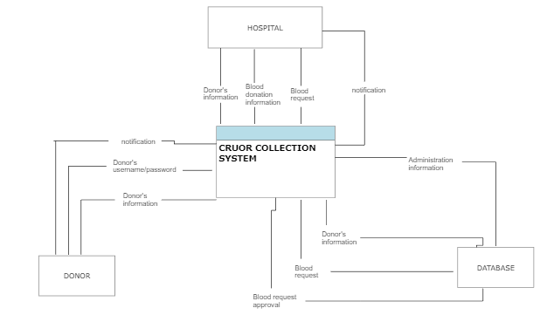
ARCHITECTURAL DIAGRAM

Slide 7
EXPECTED OUTCOME
To maintain records of blood donors information in the database system.
The hospital can send a text message to the donor when the blood is needed.
After receiving the blood, remaining donors will get the message as “BLOOD RECEIVED”.

Slide 8
REFERENCE
[1] Michael Chau, Eddie Cheng and Chi Wai Chan, Data Analysis for Healthcare: A Case Study in Blood Donation Center Analysis. Proceedings of Sixteenth Americas Conference on Information Systems (AMICS), 2019.
[2] Sham Sundaram and T Santhanam, Classification of Blood Donors using Data Mining. Proceedings of the Semantic E-Business and Enterprise Computing, pp, 2019.
[3] Li B. N & Dong, M. C. Banking on blood, Computing and Control Engineering (August–September), 22–25, 2020.
[4] Glynn S A, Kleinman S H, Schreiber G B Zuck T, McCombs S, Bethel J, Motivations to donate blood: demographic comparisons, Transfusion, 2021.

Slide 9
REFERENCE
[5] Pawar R, Thigale P, Walekar G, Thakar and D. Joshi, 2019-Optimal Facility for Location Tracking of Blood Bank and Donor. International Research Journal of Engineering and Technology 2020.
[6] Parikh S, P. Kathiria, Y. Vaghela, H. Shah and D. Dholakiya, 2018. AGeo-Location based Mobile Service that Dynamically Locates and Notifies the nearest Blood Donors for Blood Donation during Medical Emergencies. International Journal of Computer Applications 2018.
[7] Guide to the preparation, use and quality assurance of blood components, 16th edition. Strasbourg: Council of Europe 2019.

Slide 10
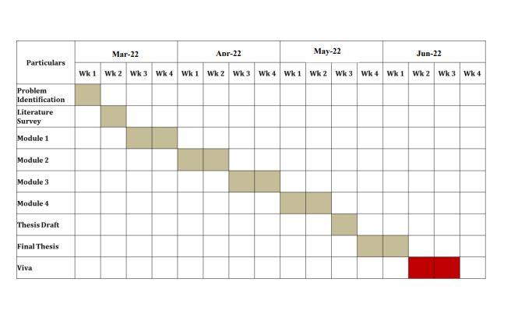
TIMELINE

Slide 11
THANK YOU

